Slide 1
EQ Test!
A C++ Programme by:
Brandon (Chief Programmer), Aik Lin (Assistant Programmer), Zhenyu (Powerpoint, Idea), Owen (Idea/Debugger) & Kai Min (Debugger).

Slide 2
Objectives of this presentation:
To explain the use of ‘fstream’ in C++.
To show off our programme, ‘EQ Test!’, and to explain how it works.

Slide 3
1. What is fstream?
fstream is a C++ library which definies 3 data types.
fstream can be classified in 3 forms:
ofstream (output file stream) is used to create files and write info to files.
ifstream (input file stream) is used to read info from files.
fstream (general file stream) can be used for both reading and writing info to files.
Definition from: tutorialspoint.com/cplusplus/cpp_files_streams.htm

Slide 4
2. EQ Test!
What is ‘EQ Test’?
‘EQ Test!’ is our own version of the regular EQ test, using C++.
Using our own algorithm, the user will answer 5 questions, and marks will be given per question (0 marks being the lowest, 5 being the highest).
At the end of the test, a word document will be generated with the user’s test results.

Slide 5
2. EQ Test!
The next few slides will show how the programme works.

Slide 6
2-1. Inputs
The programme starts with the input of user information:-
Name
Age (if you’re under 0 or above 100 years of age we’re sorry! You can’t do this test.)
Gender (if you’re NOT male or female we’re sorry! You can’t do this test. There are only 2 genders in this world, the others are invalid.)
Afterward, the information will be printed onto a text file using ofstream.

Slide 7
2-1. Inputs
ofstream is used to print out the product of the code onto a file, in this case a text file.
The code used here would be:
ofstream TestResultsFile;
TestResultsFile.open(“TestResults.txt”);
TextResults.txt being the document where the personal information, as well as the results, is printed.

Slide 8
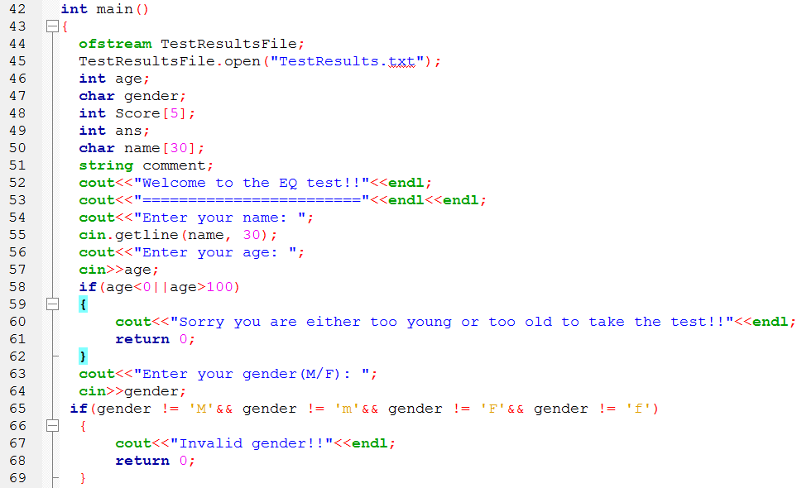

Slide 9
2-2. Test Questions & Scores
The second part of the programme would be the questionnaire.
Here, 5 questions will be asked, and each question has a marks range of 0-5.
Anything out of that range will be deemed invalid.
The total sum of the marks earned will be recorded and graded according to our grading system.
Array is used here.

Slide 10
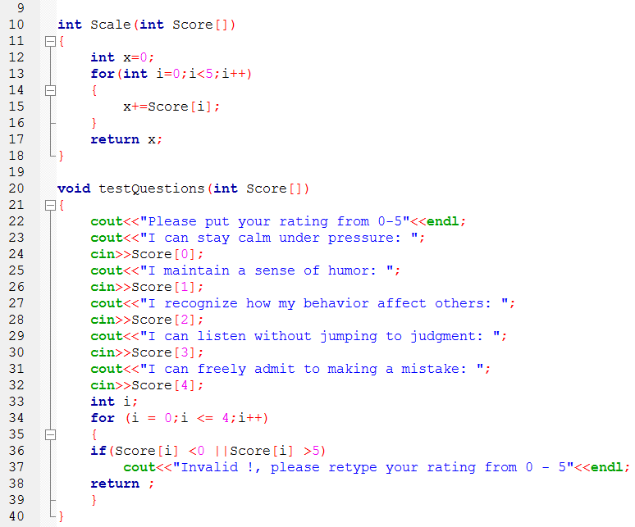
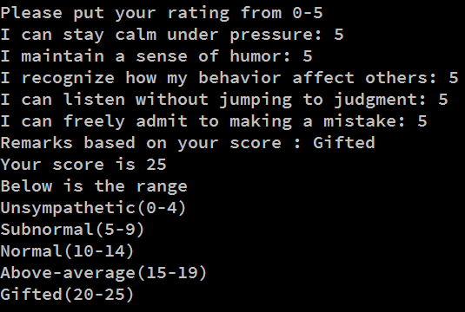

Slide 11
2-3. Grading
The remarks that were shown were displayed through ‘if-else’ commands.
However, it is different for the full range that was shown at the bottom of the programme.
To display the range as shown, ifstream had to be used.
ifstream is used to take information from files.
The code used in this case is infile.open(“Gettestresult.txt”); , with ‘Gettextresult.txt’ being the text file containing our grading system.

Slide 12
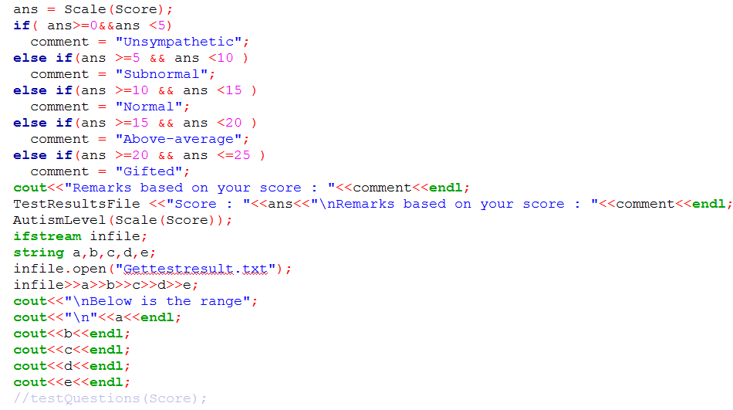

Slide 13
2-4. Test Results
After the user is done with the test, the programme will automatically print the results on a text document.
ofstream is once again used here, to print the results onto the document TestResults.txt, which also contained the personal information the user typed at the start.

Slide 14
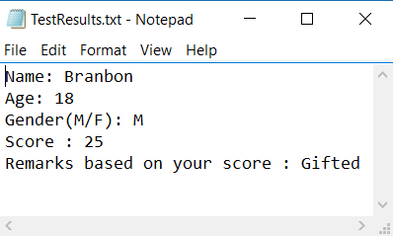

Slide 15
PRESENTATION OVER!

